Slide 1

KARABÜK UNIVERSITY FACULTY OF LITERATURE
DEPARTMENT OF SOCIOLOGY

Slide 2
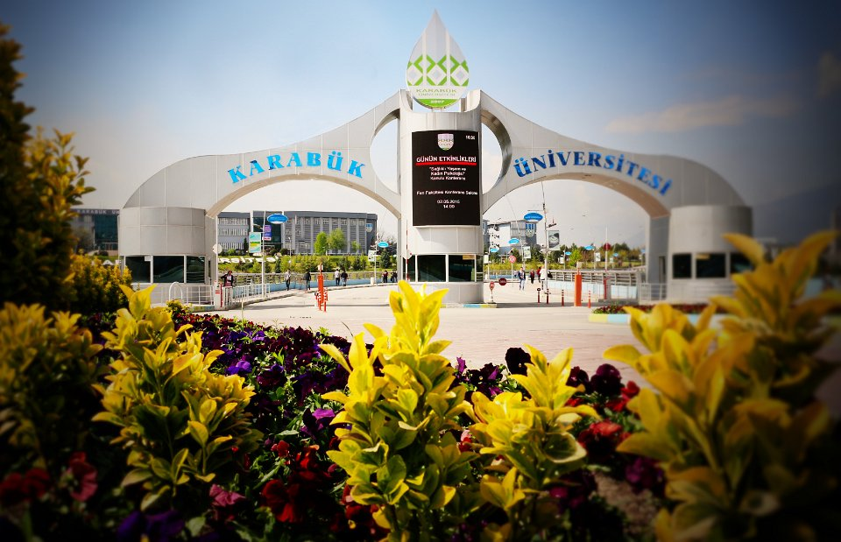

Slide 3
DEPARTMENT OF SOCIOLOGY
The Sociology Department was established in 2009 as a part of Faculty of Literature. The department, has started education since the academic year 2010-2011. Students who have the right to study in the Department of Sociology will study 8 semester.
In our department two Associate Professor, four Assistant Prof. Dr. and one research assistant are employed and number of academic staff is rapidly rising.

Slide 4
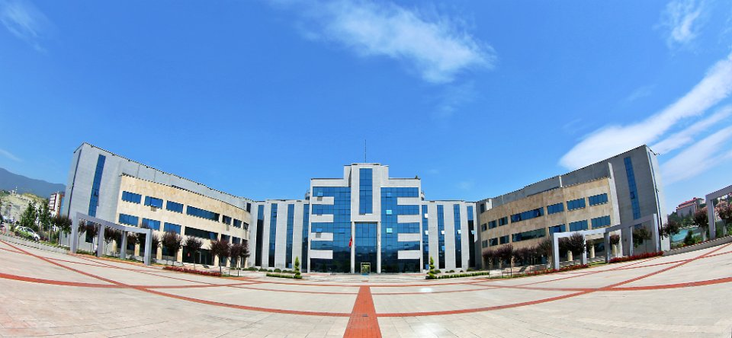

Slide 5
Academic Staff
Associate Professor Sinan YILMAZ
Associate Professor Adem SAĞIR
Assist. Prof. Dr. Kadir ŞAHİN
Assist. Prof. Dr. Halide VELİOĞLU
Assist. Prof. Dr. Zeynep KURNAZ
Assist. Prof. Dr. Özkan ÖZTÜRK
Research Assistant Semra UZ

Slide 6
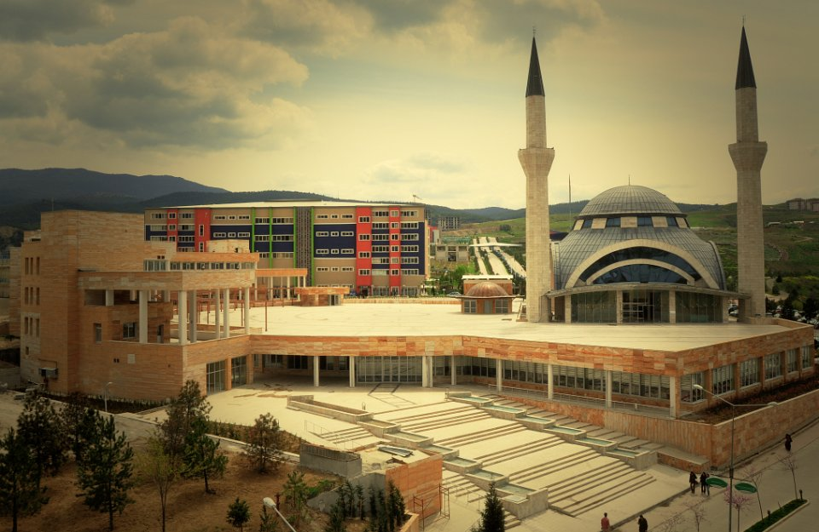

Slide 7
DEPARTMENT OF SOCIOLOGY
Department of Sociology includes three sub-departments: “General Sociology And Methodology”, “Institutional Sociology” and “Applied Sociology”. The courses are given in these departments.

Slide 8
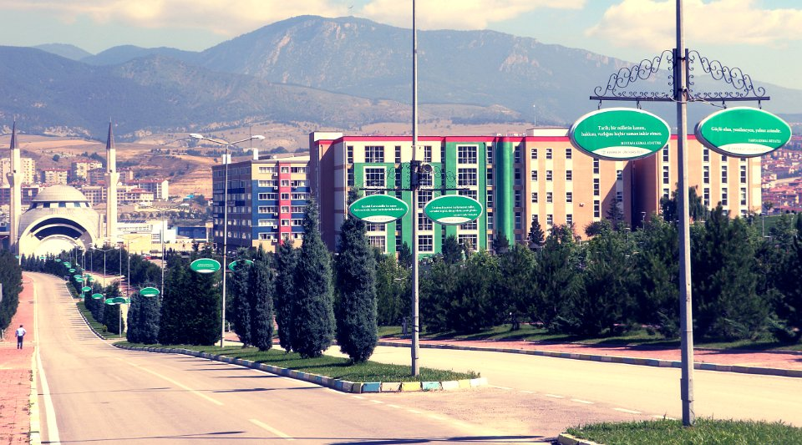

Slide 9
DEPARTMENT OF SOCIOLOGY
This program aims to train sociologists who can combine their theoretical knowledge required for teaching sociology with practice, follow new approaches emerged in the area, use statistical programs as like as SPSS expertly, follow scientific and technological developments, analyze current social problems and contribute to the sociological works.
The Graduates of the Department of Sociology, have job opportunities in institutions of public and private sector such as various ministries of government, civil society organizations, research companies, advertisement agencies, marketing firms.

Slide 10
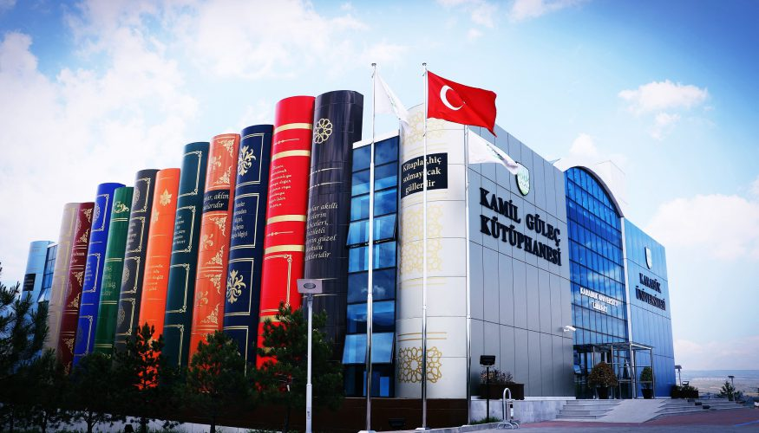

Slide 11
Library Services
Central Library of our university was opened on January 2, 2009 on the basis of Faculty of Technical Education collection. Apart from central library, there are also department libraries at Fethi Toker Faculty of Fine Arts and Design, Safranbolu and Eskipazar Vocational School. Our libraries provide printed and electronic information resources in order to support the work of scientific research of our university; save and organize these resources in electronic form in accordance with the rules of library. It also provide the fastest and easiest way to access.

Slide 12
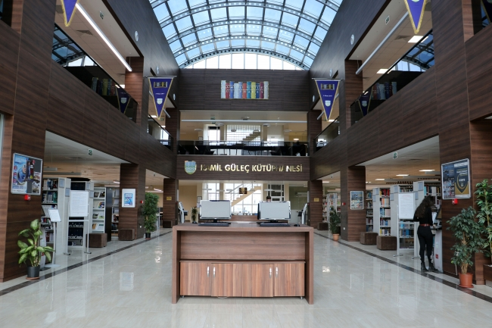

Slide 13
Library Services
Karabuk University Library gives much importance to user satisfaction by acting with the principle of continuous improvement and self-renewal in terms of service quality and resources owned. In parallel with the rapid growth of the university, our library continuously increases its print and electronic resources in order to meet the growing needs of users and makes them available to users. By the end of 2012, printed sources have increased to 40000 and electronic resources have increased to 2.5 million. The average of 5000 materials are added to the collection each year. The materials which aren’t available in our library can be obtained from another library within the framework of co-operation between libraries. There is a spacious study hall and a computer room for users to access electronic resources.

Slide 14
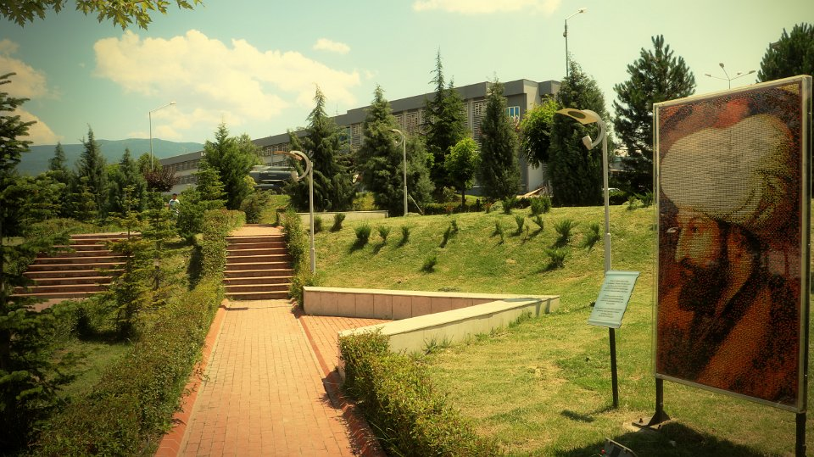

Slide 15
EXCHANGE PROGRAMS
Erasmus: http://uluslararasi.karabuk.edu.tr/hayatboyu-en
Farabi:
http://uluslararasi.karabuk.edu.tr/farabi-en
Mevlana:
http://uluslararasi.karabuk.edu.tr/mevlana-en

Slide 16
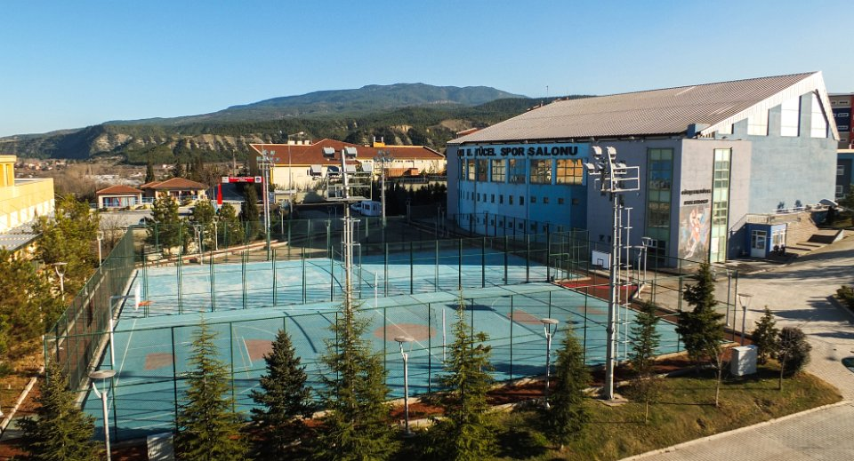

Slide 17
