Slide 1
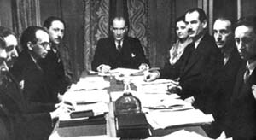
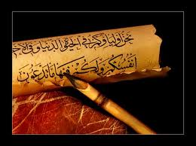
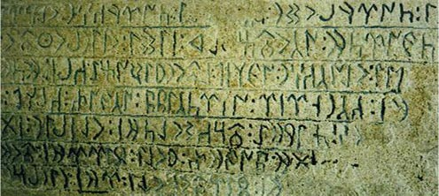
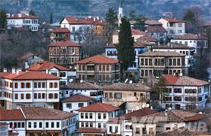
Karabuk University
Faculty of Letters
Turkish Language and Literature

Slide 2
Department of
Turkish Language and Literature
The Department of Turkish language and literature started education with 41 students in the 2009-2010 academic year.
Turkish language and literature is an outstanding and promising field of expertise among the Social Sciences in terms of its function to transfer our cultural heritage to the future and the breadth of the field it covers.
The aim of our department is to educate individuals who make use of the knowledge of Science, Technology and art in the light of universal values and to present the production in the fields of research, education and service for the benefit of the community.

Slide 3
Why the Department of
Turkish Language and Literature?
Next to the overall mission of the Department of Turkish language and literature department, Karabük and Environment language, literature and folklore sources to do research about able-raising and aims to contribute to the promotion of the cultural heritage elements of the region.

Slide 4
Acquirements of the Department
The students of the Department of Turkish language and Literature will be familiar with the Turkish language, Turkish literature and Turkish cultural life in the light of the research and examination methods of the science of literatüre. They will have information about the historical development of Turkish language and literature, important personalities and works. They will be able to make comparative studies with the literature of other Turkic republics and distinguished works of Contemporary World Literature, will be able to look at the literary work with a different view from the ordinary reader, will be able to gain awareness of Turkish, correct writing and speaking skills. Apart from these students; through Ottoman Turkish courses, elective Eastern Language (Persian or Arabic) courses, English and contemporary Turkish dialects courses, will be able to have language gains and reflect these skills in different fields today where interdisciplinary interaction is very important
In summary, we say that it is a privilege to study in the Department of Turkish language and literature, which has a very important role in promoting the cultural heritage of the Turkish nation to future generations.

Slide 5
Job Opportunities of Our Graduates
Students who have graduated from the Department of Turkish language and literature can work as a teacher of Turkish language and literature in public and private schools under the Ministry of National Education.
In addition, our graduates can work as trainers in all kinds of educational institutions such as lecture halls and study centers; researchers in related departments of universities; experts in public institutions such as Ministry of Culture, Turkish Language Institution, TRT, RTUK, DPT.

Slide 6
Information About Our Department
In our department we have six sub-departments;
Modern Turkish Literature
Old Turkish Literature
Folklore
Modern Turkish Language
Old Turkish Language
Contemporary Turkish Languages and Literatures
There are four associate professors, eight assistant professors and one research assistant in our department.

